Slide 1
Trading Bot
Financial Programming with Ritvik

Slide 2
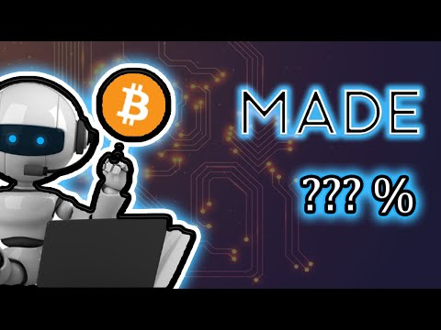
Bitcoin Trading BOT [Binance Tutorial 2021]. “UN”exptected Results?! 😲
We made Bitcoin Trading bot using binance.
The link of the YouTube Video is: https://youtu.be/XkjpPecU2e8

Slide 3
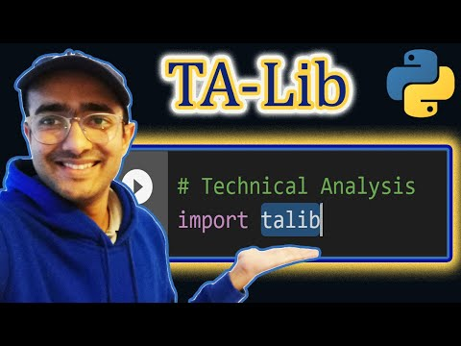
TA-Lib Python Tutorial [easy INSTALL] Technical Analysis Library 2021 🔴
Learn how to install and use TA-Lib in the best way
The link of the YouTube Video is: https://youtu.be/30BaSfz0FGE

Slide 4

WebSocket Binance Python [Bitcoin day Trading BOT Step1]🔴
Learn how to use websocket-client in the best way
The link of the YouTube Video is: https://youtu.be/z2ePTq-KTzQ

Slide 5
Build a basic Paper Trading Simulator in Python: ONLY 25 lines🔴
Learn how to build a basic Paper Trading Simulator in Python in the best way.
The link of the YouTube Video is: https://youtu.be/FD1dFKIUvnI

